Slide 1
Arduino gpio programming

Slide 2
Learning objectives
By the end of this lecture, you will be able to:
Understand the general architecture of a simple microcontroller
Read and Write to devices using the General Purpose I/O (GPIO) pins.
Before that, we first need to get familiarized with the 1’s and 0’s…

Slide 3
Binary
In all digital systems, data is represented as 1’s and 0’s, namely called the Binary Number System.
The 1’s and 0’s are logical representations.
In actual hardware, they are still represented as voltage signals. Logic ‘0’ is always 0 volts. The voltage of logic ‘1’ depends on the microcontroller’s supply voltage. If it is powered through 5V, then logic ‘1’ is also 5V. If it powered through 3.3V, then logic ‘1’ is also 3.3V.

Slide 4
Binary representation
Bit (Binary digit)
0 and 1
Represent false and true in logic
Represent the low and high states in electronic devices
Other units
Byte: 8 bits
Nibble: 4 bits (seldom used)
Word: Multiples of byte (eg: 1 byte, 2 bytes, 4 bytes, 8 bytes, etc.), depending on the architecture of the computer system

Slide 5
Binary representation
N bits can represent up to 2^{N} values.
Examples:
2 bits → represent up to 4 values (00, 01, 10, 11)
3 bits → rep. up to 8 values (000, 001, 010, …, 110, 111)
4 bits → rep. up to 16 values (0000, 0001, 0010, …., 1111)
To represent M values, log₂M bits are required.
Examples:
32 values → requires 5 bits
64 values → requires 6 bits
1024 values → requires 10 bits
40 values → how many bits?
100 values → how many bits?

Slide 6
Weighted positional number system
A weighted-positional number system
When the Base or radix is 10, it refers to the total number of symbols/digits allowed in the system
Symbols/digits = { 0, 1, 2, 3, 4, 5, 6, 7, 8, 9 }
Position is important, as the value of each symbol/digit is dependent on its type and its position in the number
Example, the 9 in the two numbers below has different values:
(7594)₁₀ = (7 × 10³) + (5 × 10²) + (9 × 10¹) + (4 × 10⁰)
(912)₁₀ = (9 × 10²) + (1 × 10¹) + (2 × 10⁰)
Same principal is applied to Binary Systems with Base-2.

Slide 7
Binary-2-decimal
For binary number with n digits: d_{n-1} ... d₃ d₂ d₁ d₀
decimal = d₀×2⁰ + d₁×2¹ + d₂×2² + ...
Example
Find the decimal value of 111001₂:
111001₂ = 1⋅2⁵+1⋅2⁴+1⋅2³+0⋅2²+0⋅2¹+1⋅2⁰ = 57₁₀

Slide 8
Hexadecimal-2-binary
Hex, or hexadecimal, is a number system of base 16.
As hex system has 16 digits, the extra needed 6 digits are represented by the first 6 letters of English alphabet.
Hence, hex digits are 0,1,2,3,4,5,6,7,8,9 together with A, B, C, D, E, F.
To convert Hex to Bin, split it into groups of 4 starting from right.
Hex to binary conversion examples
(1E3)₁₆ = (0001 1110 0011)₂
(0A2B)₁₆ = (0000 1010 0010 1011)₂
(7E0C)₁₆ = (0111 1110 0000 1100)₂

Slide 9
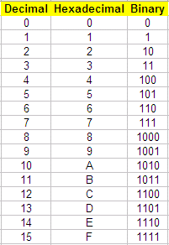
Binary-2-hex
For conversion from Binary to Hex, group the Binary bits into groups of 4 starting from the Least-Significant-Bit (LSB).
Binary to hex conversion examples
(1110)2 = 0Eh
(111001)2 = 39h
(10011100)2 = 9Ch

Slide 10
Naming conventions
There are a variety of naming conventions for the different representations.
Binary:
10012
1001b
0b1001
Hex:
5A16
5Ah
0h5A
0x5A

Slide 11
Bitwise operators in c
C has the following bitwise operators:
AND (&), OR(|) and NOT (~)
The table below shows how these work.

Slide 12
masking
The bit-wise operators are very useful for setting or
clearing a particular bit.
To clear a bit, create a “mask” where that bit is 0 and all others are 1, and do a bit-wise AND.
To set a bit, create a “mask” where that bit is 1 and all others are 0, and do a bit-wise OR.
We will consider a variable “value” set to 0b1101 1110 (0xDE). We want to clear bit 3 and set bit 5.
Bits are numbered 0 to 7 from right to left

Slide 13
masking
Clearing Bit 3
Setting Bit 5
1

Slide 14
masking
The C Code to accomplish this is shown below.
int value=0xde;
…
// Clear bit 3
value &= 0xF7;
// Set bit 5
value |= 0x20;

Slide 15
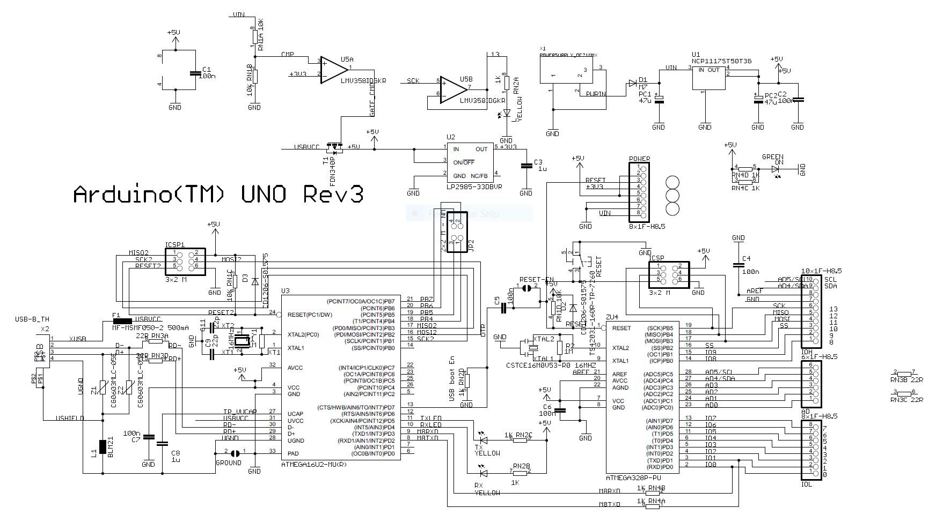
Arduino uno embedded systems board

Slide 16
Lets take a closer look

Slide 17
Atmel atmega architecture
Specifications:
20 MHz 8-bit microcontroller
32 single-byte registers.
I/O Options:
23 general purpose I/O (GPIO) lines.
6 analog-digital converter channels (analog in).
3 PWM channels (analog out).
2 8-bit counters and 1 16-bit counter.
USART (RS232-like interface)
Two-wire Interface (TWI).
Serial Peripheral Interface (SPI).

Slide 18
Atmel at328p

Slide 19
Mapping

Slide 20
Gpio programming
The AVR General Purpose Input Output (GPIO) ports are
used for communicating with digital inputs and outputs:
Switches.
LEDs.
Digital circuits.
Etc. etc.

Slide 21
The internals of a GPIO pin

Slide 22
GPIO ports
There are three GPIO ports labeled
PORTB, PORTC, and PORTD,
corresponding to pins on the AVR.
Pins are labeled PB0-7 (8 lines), PC0-6 (7 lines) and PD0-7 (8 lines), totaling 23 pins.
These pins are also shared with other functions:
E.g. PD0 and PD1 are also used by the
receive (RXD) and transmit (TXD) lines
for the USART.

Slide 23
Gpio programming
To program a GPIO port, we must first set the direction of the individual pins. This is done using the DDRx registers:
Example shown is for PORTB:
A “1” in bit 6 will set DB6 to be output, a “0” will set it to be input.

Slide 24
Gpio programming
Once the pin directions have been configured, you can use the PORTx registers to write the pins.
If bit 3 in DDRB was set to 1, and if your program wrote a “1” to bit 3 in PORTB, then pin PB3 will be asserted HIGH.

Slide 25
Gpio programming
Use PINx to read the pins.
Use bit-masking to test the status of a particular pin. E.g. to test pin PB3
result=PINB & 0b00001000;
If PB3 contains a “1”
If PB3 contains a “0”

Slide 26
GPIO Programming Example 1
In this example, we will assume that an LED has been connected to Arduino Pin 13 based on the following circuit.

Slide 27
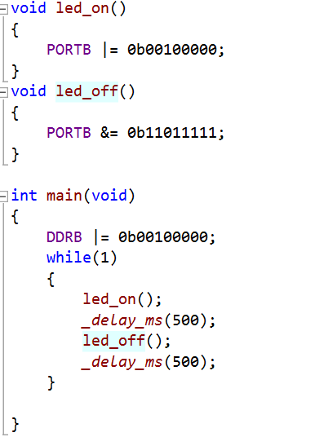
Programming blinky

Slide 28
GPIO Programming Example 2
Same program as before, except that this time we toggle the LED on and off using a push button switch connected to pin 10 using this circuit:

Slide 29
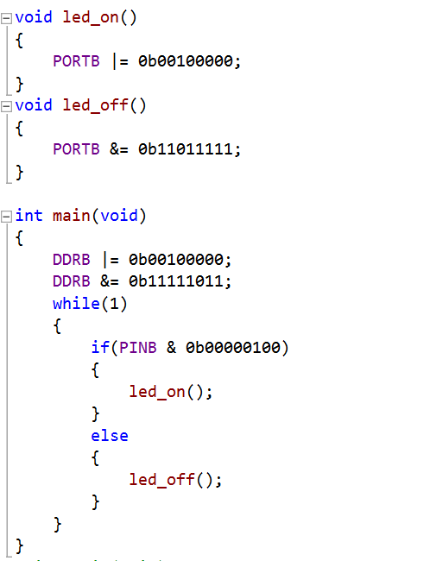
Programming switch & LED

Slide 30
summary
In this set of slides you have
Been introduced to Number Systems and Conversions
Understood some basic Microcontroller Concepts
Learnt how to program GPIO’s at the register level
The process of extracting useful information from the datasheet is critical when you want to start developing your own projects using any Microcontroller.

